Slide 1
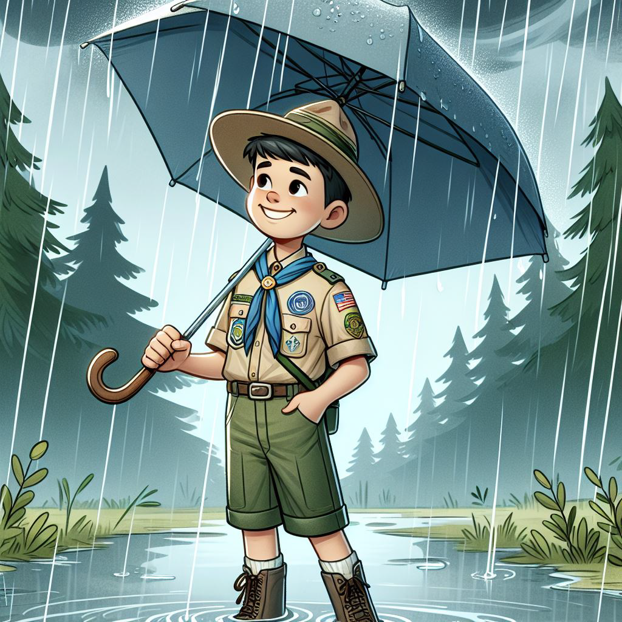
Welcome to the April Roundtable!

Slide 2
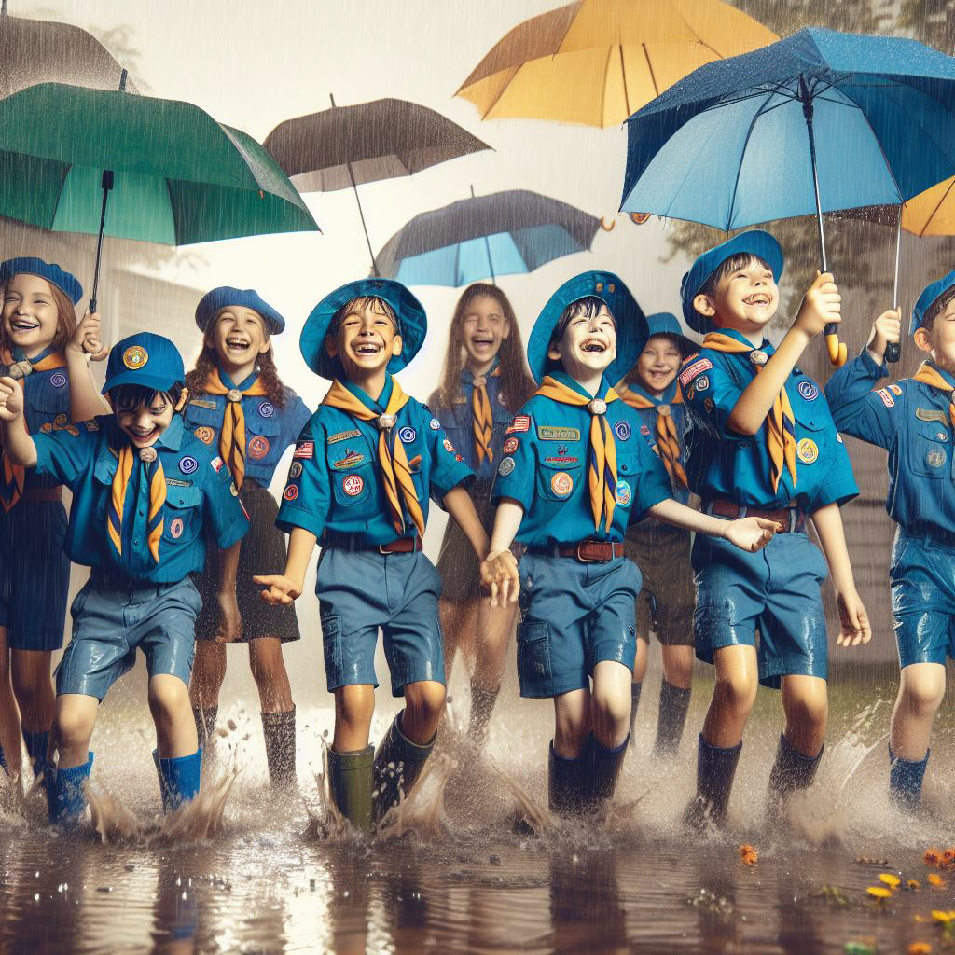
The Outdoor Code
As an American, I will do my best to –
Be clean in my outdoor manners.
Be careful with fire.
Be considerate in the outdoors.
Be conservation minded.

Slide 3
TONIGHT’S AGENDA
6:30-7:00: Sign-In and networking.
7:00-7:15: Combined Opening in the Auditorium:
Flag presentation, oath & law & Outdoor Code.
Scouter of the Month presentation
7:15-7:50:
Cub Scout Program in the Fellowship Hall – Let’s Camp
SUVCW in the Sanctuary – Eagle Scout awards
SBSA Program in the Sanctuary – Safety around water
Pack and Troop Mail, coffee and cookies in the Lobby.
Breakouts:
  Merit Badge Counselor Training in Classroom 111.
  OA Meeting in the Youth Hall (Room 127).
7:50: Combined closing:
Cubby Bear award & sleeping bag awarded
Door prizes.
Scoutmaster’s Minute, and benediction.

