Slide 1
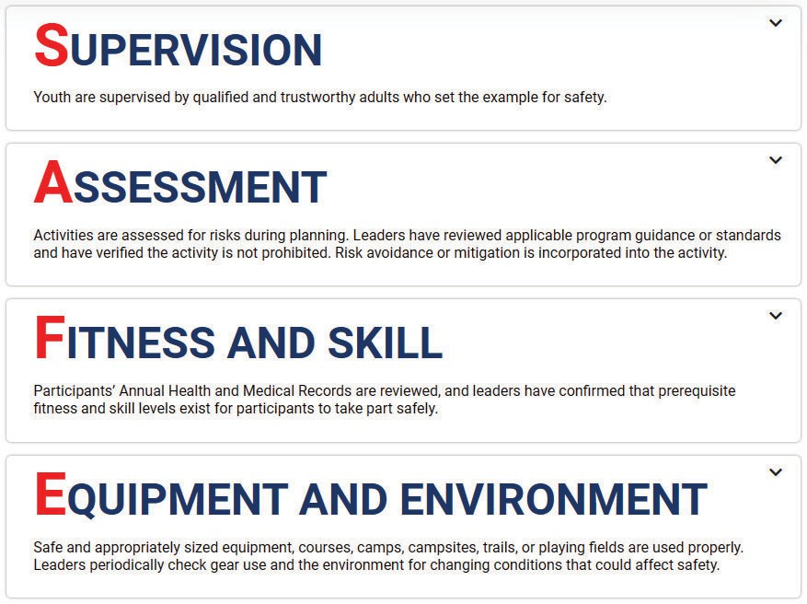
Aquatics Supervision is a resource for unit leaders to apply the four points of SAFE when delivering swimming and boating activities as part of the Scouting Program. The guide covers programs, policies, training courses, skills, equipment, environments, risks, risk mitigation, and prohibited activities. However, every possible contingency may not be covered with a hard-and-fast rule, and rules are poor substitutes for experience. Ultimately, each and every leader must decide if they are sufficiently trained, experienced, and informed to make rational decisions to meet SAFE expectations.

Slide 2
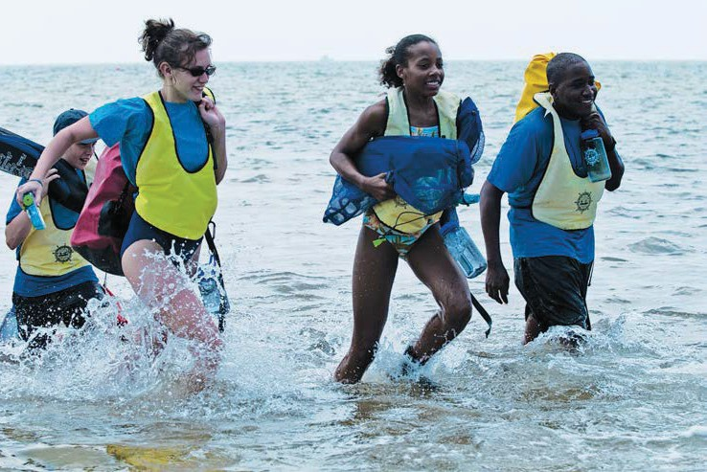
1
Chapter
Qualiied Supervision: Roles and Responsibilities of Unit Leaders
All program divisions of the Boy Scouts of America, from Cub Scouting through Venturing, use responsible outdoor adventure programs to promote character development and values-based leadership training. Activities in and on the water constitute a large subset of the programs that attract youth to and retain youth in the movement. Millions of youth participate yearly in aquatics activities during BSA outings under the leadership of more than a million adult volunteers.
The Scouting program is delivered through small local groups led by volunteers and sponsored by local civic clubs, churches, schools, and other organizations. Those groups, known generically as units, vary in size and name depend- ing on the age of the youth being served. Units within a geographic division, or district, are assisted by professionals employed by a council. Individual units often take advantage of council summer camps where trained staff members assume the responsibility for quality program delivery, but many units also conduct aquatics activities under their own leadership. Youth camps conducted by other organizations are often standalone programs limited to a short duration in the summer. BSA camps are simply one element of a year-round unit program. The BSA encourages unit aquatics initiatives, whether it is a den leader taking advantage of a parent’s offer of a backyard pool, or a crew taking off on its own Boundary Waters canoe trek from a Northern Tier National High Adventure base camp.

Slide 3
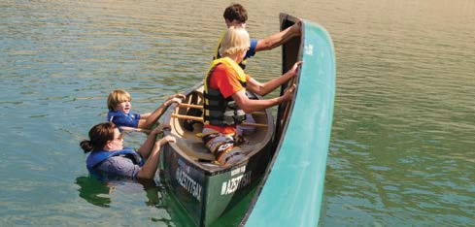
A key to safe, effective unit aquatics activities is informed and conscientious unit leadership. Serious mishaps during BSA events are rare. Although various aquatics activities can involve some degree of risk, those risks are mitigated by the training and commitment of BSA volunteer leaders. Properly conducted swimming and boating programs are safe as well as fun, exciting, and rewarding.
ity to others. For example, a Scout troop at a water park with trained lifeguards on duty need not assign separate unit personnel to perform water rescue. A Venturing crew on a whitewater excursion may rely on a licensed outfitter to provide the necessary equipment and trained guides.
As the above examples demonstrate, a unit can participate in fun and challenging aquatics activities even if unit leaders lack the knowledge and skill to conduct the activity themselves. On the other hand, a troop on its way to a jamboree need not forgo the use of a hotel pool just because the facility does not employ a professional lifeguard, provided unit leaders are properly prepared.
According to BSA guidelines:
All swimming and activity afloat must be super- vised by a mature and conscientious adult age 21 or older who
understands and knowingly accepts responsibility for the well-being and safety of youth members in their care,
This publication provides the unit leader with information needed to determine when proper safeguards are in place for a unit aquatics activity, whether those safeguards are provided by a facility operator or the unit itself. Basic skills needed by the unit to function on its own are reviewed, as well as what to look for in a facility or operator.
is experienced in the particular activity,
is confident in their ability to respond appropri-ately in an emergency, and
is trained and committed to the nine points of BSA Safety Afloat and/or the eight points of Safe Swim Defense.
After a review of this material, unit leader􀀁 should be confident in their ability to judge when an aquatics activity is safe, when the risk is unacceptable, or when their background is insufficient to make that determination. Experienced, informed leaders often develop a sixth sense or intuition with regard to an action. When an activity exceeds the leader’s comfort zone, it should be curtailed or modified.
The den leader, Cubmaster, Scoutmaster, or crew Advisor who accompanies the unit on an outing is always respon- sible for the first and last bulleted points. However, BSA policies do not specify that the unit leader must be the one who satisfies all of the above criteria. Under appropriate circumstances, the unit leader may delegate responsibil-
Chapter 1: Qualified Supervision: Roles and Responsibilities of Unit Leaders

Slide 4
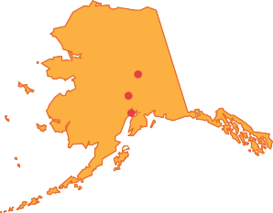
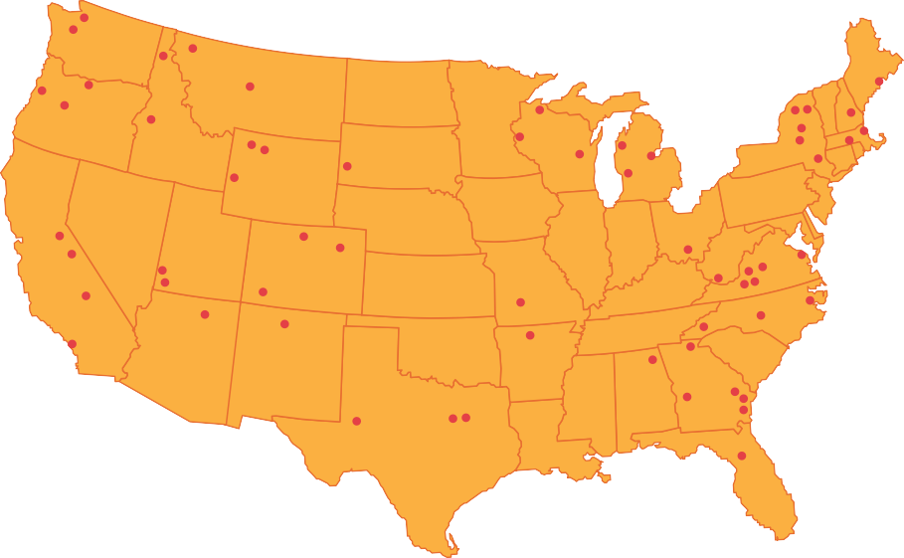
High-Adventure Aquatics Programs
More than 115,000 units are served by nearly 300 local councils, each of which operates at least one of the more than 400 organized BSA camping facilities. Almost all of the council camps offer basic programs in swimming, lifesaving, rowing, and canoeing. Some include sailing, kayaking, motorboating, and waterskiing. More than 50 percent of the camps offer units the option of some type of float trip, on or off council property. Some are simple overnight trips on flat water; others are weeklong excursions on flowing water.
own adult leadership, although occasionally a council may recruit a contingent from several units. Northern Tier normally provides a trained staff member to accompany inexperienced groups, but experienced units may elect to travel without guidance. Each summer, roughly 5,000 Scouts in groups of six to 11 take wilderness canoe trips lasting six to 10 days.
The Charles L. Sommers base camp near Ely, Minnesota, has been the starting point for trips into the Boundary Waters Canoe Area Wilderness since 1923. The camp operates a radio base station that forms an important part of the emergency response system for the area. Commercial outfitters often instruct their customers to contact a BSA crew in case of emergency. The Rogert base camp near Atikokan, Ontario, accesses Quetico Provincial Park from the Canadian side. A base camp in Bissett, Manitoba, stages treks into Atikaki Park via float plane to Scout Lake.
The National Council has approved roughly 60 of the council camps as high-adventure bases with treks lasting five days or more. While some feature backpacking, others offer canoeing, kayaking, rafting, or sailing. Some offer scuba certification or other advanced skills as a resident program. Most will accept out-of-council troops, and several accommodate coed crews. A listing of the camps and their programs can be found at the national
BSA website, www.scouting.org.
The National High
Adventure Sea Base (www.bsaseabase.org) began operations in the 1970s and now runs two staging areas in the Florida Keys. The sea base operates one of the largest scuba programs in the United
The BSA also operates four national high-adventure programs, several of which offer aquatics programs.
The Northern Tier National High Adventure Program (www.ntier.org) stages canoe treks from three base camps. As is the model for Scout camping in general, a troop or crew that meets year-round comes with its
States with roughly 1,500 participants yearly. While many participants seek scuba certification, those already certified may dive from boats stationed at
the base or from live-aboard sailboats. Another 9,000 or
so engage in
Chapter 2: BSA Aquatics: A Wealth of Opportunities 11

Slide 6
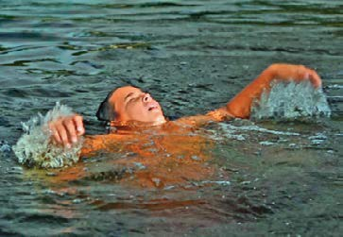
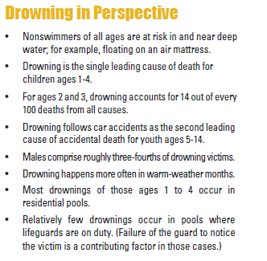
The rest of this section will review common causes of drowning, introduce the basic elements of Safe Swim Defense and Safety Afloat procedures for drowning prevention, and outline the general elements of an emergency action plan for swimming and boating activities. The text will expand on rules and procedures, surveillance, emergency action plans, and rescue skills for specific activities at various sites. Should an emergency arise, water rescue is relatively safe and simple when care is taken to operate in a safe setting with appropriate rescue aids at hand. Even so, situations in which rescue skills are needed should be extremely rare. The overall safety of an aquatics activity or facility should be judged by the absence of crisis and rescue. If rescues are commonplace, inadequate precautions have been taken to ensure the highest safety standards, even if all the rescues are successful.
Two well-meaning and conscientious adults took a newly formed youth group on an overnight campout. The campsite was near a small, slow-moving river, and the group waded into the water from a shallow sandbar. Two boys, who could not swim, stepped off the sandbar into the channel where the water was over their heads. They did not call out for help, submerged, and drowned without anyone realizing they were in peril.
Millions of Scouts and millions more in the general public enjoy water sports year-round without any adverse experience. Water and people mix well when simple precautions are taken. However, not everyone realizes the need for such precautions. Each year, several thousand people drown in the United States. Thousands more are taken to emergency rooms due to water-related incidents, and not all of those people completely recover. Thousands of others are saved from injury by alert lifeguards or other rescuers.
Both incidents illustrate the “instinctive drowning response” first publicized by Frank Pia in the 1970s. True nonswimmers—that is, those who have never supported themselves in deep water—are often in danger as soon as they enter deep water. Such persons, from toddlers through adults, are unable to call for help and unable to move even a few feet to safety, whether safety is a pool side, the other side of a drop-off, or a flotation device they fell from. To an uninformed observer, such victims may even appear to be playing in the water.
“Drowning is an unlovely thing.”
—Wilbert Longfellow, early BSA water safety consultant
Two unfortunate tragedies dramatically illustrate how the public at large sometimes underestimates the danger in a seemingly benign situation.
A mother arranged to chaperone a group of teenaged girls at an overnight stay at a hotel as a treat for her daughter’s birthday. While the group was using the hotel pool, the daughter, who could not swim, moved into water over her head. The mother noticed the daughter acting strangely and jumped into the water when the daughter did not respond to her calls. The mother, as her feet hit the bottom, managed to push her daughter a short distance to the side, where the other girls helped her out. With all their attention focused on the daughter, no one noticed that the mother, who also could not swim, could not move herself the short distance to safety. The mother drowned, unable to call for help.
20 Chapter 3: Safety First

Slide 7
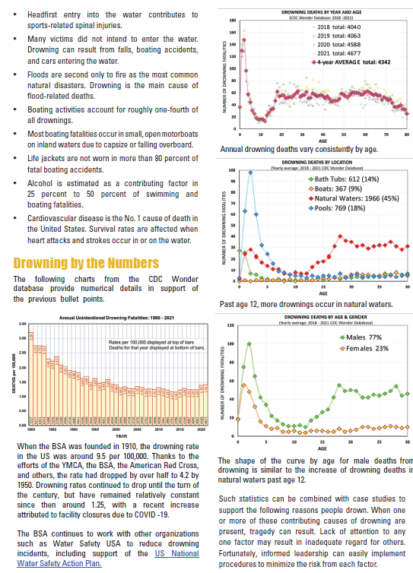

Slide 8
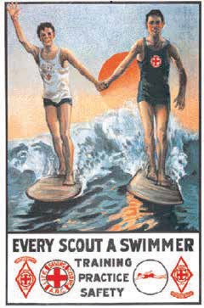
swimmers engaged in water sports. Although it is often possible to determine that an area is unsafe simply by looking, confirming that an area is safe may take an underwater search of a swimming area or advanced scouting of a river.
Poor judgment. Often, the skill of those taking part determines how safe an area or activity is. Participation in an unsafe activity reflects a lack of knowledge or judgment. Examples include overestimating swimming or boating skill, failing to wear a life jacket, diving into shallow water, and alcohol or other drug abuse. Education is one key to prevention. Rule enforcement is another.
Inadequate supervision. A toddler left unattended near a pool is an example of inadequate supervision. Allowing youth groups to engage in unsafe activities is another. Qualified supervision and discipline provide protection.
“Every Scout a swimmer” was an early slogan of the Boy Scouts of America. No other factor contributes more to the safety of an individual in the water than the ability to easily move through it. Unit leaders today should strive to meet the 1924 goal.
Accident Prevention: Elements of Safe Swim Defense and Safetv Aloat
Each of the above factors contributing to drowning is specifically covered by elements of the BSA Safe Swim Defense and Safety Afloat plans. The primary emphasis of each plan is prevention. Qualified supervision and discipline guard against unsafe activities and ensure that each point is properly implemented. A personal health review addresses medical complications. Ability groups, swimming ability, and skill proficiency match activities, areas, and equipment to abilities. Safe swimming area, equipment, including life jackets, and planning concern safe physical arrangements.
Poor swimming skills. Many people who drown lack the skill to swim only a few feet to safety. Knowing how to swim is the best protection against drowning. Although poor swimmers can safely participate in shallow-water or near-shore activities, a conscientious BSA leader will encourage everyone in the unit to advance at least to the BSA “swimmer” level. Exhaustion is often cited as a factor in drownings when poor swimmerV overestimate WKHLU swimming ability. A swimmer who has learned restful swimming strokes seldom has that problem.
Each plan covers preparation, including recognition and response, should an accident occur. The buddy system, lookouts, and response personnel provide eyes and ears alert for trouble and ensure that someone is available to provide safe and effective assistance. They are integral parts of emergency action plans.
Medical complications. Drowning can result when strokes, heart attacks, diabetic reactions, or seizures occur in the water. Such conditions can cause an otherwise good swimmer to become incapacitated. Prevention relies on medical screening. Supervisors should review the health histories of all participants and physicians’ recommendations. Special precautions may be needed for those with certain medical conditions.
Unsafe areas. Unsafe situations for swimming and boating include swift water, submerged obstacles, ocean rip currents, high waves, and cold water. Even a simple drop-off is unsafe for a nonswimmer, which means extra precautions are needed for poor
Safe Swim Defense and Safety Afloat are the backbones of safe unit swimming and boating activities. They define standard operating procedures for BSA water sports and the standard of care expected of unit leadership. The points are introduced here to show their close relationship to factors that lead to drowning. However, a simple listing does not provide sufficient information to actually implement the procedures. Each item will be fully explained in subsequent discussions.
22 Chapter 3: Safety First

Slide 9
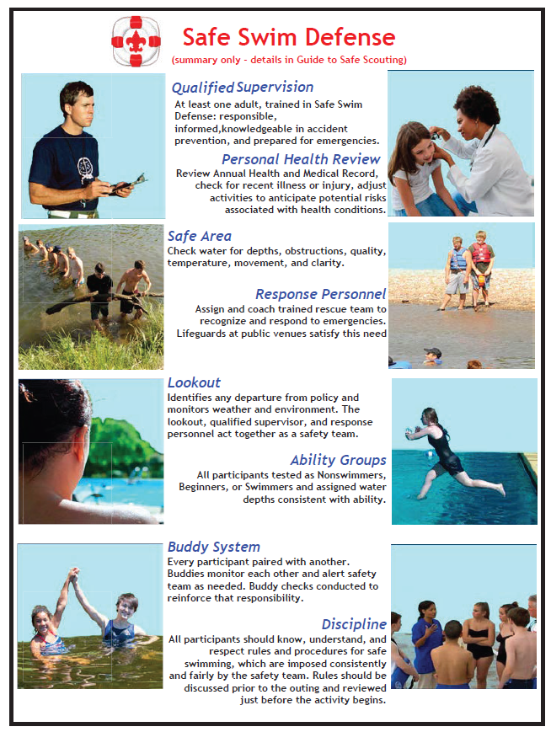

Slide 10
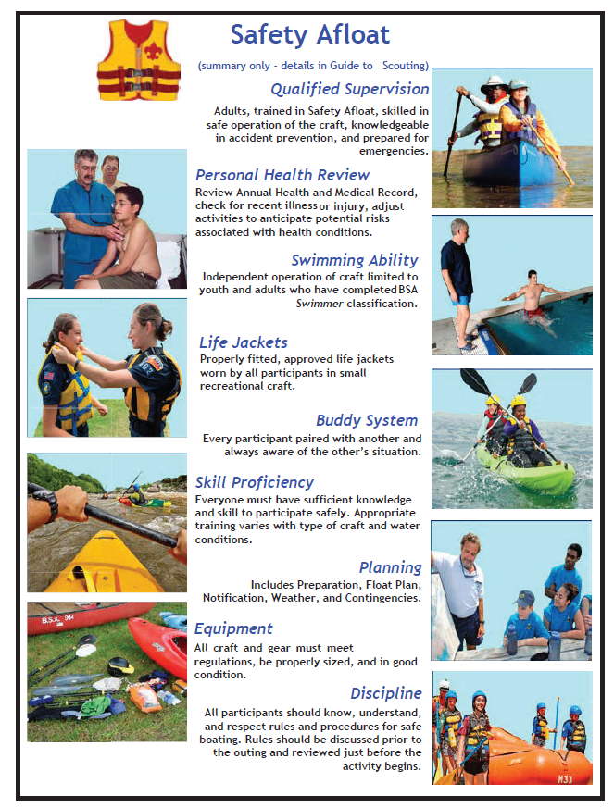

Slide 11
Fatigue is a major cause of highway accidents. Don’t drive while drowsy.
All driving, except for short trips, should be done in daylight.
To establish negligence, the plaintiff must first show that the defendant had a duty to act. A duty to act, or duty of care, is established when a person or organization accepts responsibility for the safety of another. A parent has a duty to a child. In loco parentis means that another person has temporarily assumed a parent’s responsibility. A person who invites a neighbor’s child to play in a backyard wading pool has a duty of care, as does a Scoutmaster supervising a troop swim on a campout.
Highway transport of boats, by trailer or on roof carriers, requires special consideration and will be discussed further in sections on various craft.
Tour and Activitv Plans
There is no national policy that requires units to file a formal tour plan with local councils. However, informed planning at the unit level is a practical concept that fosters successful, safe activities and is recognized as such in the BSA Safety Afloat policy.
After a court determines that a duty of care exists, the next step is to determine the standard of care that applies to that duty. The parent watching neighborhood children in a wading pool may only be required to act as a “reasonable” or “prudent” person would under
the circumstances. A bystander applying first aid at an accident scene is generally held to a lesser standard of care than an on-duty emergency room physician. Lay persons are often afforded some legal protection by Good Samaritan laws, so long as they act in accord with and within the limits of any training they have received. Note that the standard of care expected of a volunteer leader may be modified by the training and policies imposed by a sponsoring organization. For example, a plaintiff may establish negligence by showing that the actions of a Scout leader were not in accord with BSA policy or that they were inconsistent with how similarly trained persons would have acted.
Legal Considerations
A leader’s moral obligation to protect the youth
under WKLHU concerns Nevertheless,
supervision about
some
should overshadow any
legal accountability. volunteers may have
concerns about legal exposure should something
happen despite their diligent efforts. The best way to avoid litigation is to prevent physical or mental trauma
through safety awareness, preparation, consistent application of policies, and other tools of risk management. The material reviewed here is presented as an additional aid to ensure preparedness, not as a reason to forego the pleasure, challenges, and satisfaction that arise from participating in aquatics activities.
Failure to perform the duty of care to the appropriate standard is called a breach. A breach by itself does not constitute negligence. Harm or damage has to result from the breach.
Most legal actions that result from an accident during a supervised youth activity are civil: an injured
party,
or plaintiff, charges a person or
The following examples, some of which may fit in more than one category, may support a claim of negligence. Numerous other examples can be constructed simply by taking the inverse of any previously stated safety policy.
organization, the defendant, with responsibility for the accident. Legal responsibility, or liability, is the issue, and the court may award compensation for both actual damages and as punishment (a punitive award). In a criminal case, the government charges
the defendant with violating a law. The issue is guilt, which if proved, causes the court to impose punishment.
Failure to provide a safe environment:
No boundary line is used between deep water and the nonswimmer area.
Youth are provided with adult-sized life jackets.
A tripping hazard exists where sections of a floating dock are attached.
Although civil suits may be initiated under a wide variety of circumstances, the plaintiff generally must establish that harm has resulted from negligence, or the failure to act properly. Negligence need not be intentional or willful. It arises when the defendant fails to act appropriately, or acts improperly. Negligence can result from carelessness, poor judgment, forgetfulness, inexperience, ignorance, or failure to notice and/or
^{Chapter}c^{3:}o^{S}rªr^{f}e^{et}c^{y}t^{Fi}a^{rst}hazardous situation.
28

Slide 12
Improper action:
Many BSA volunteers also assist other organizations, such as schools, churches, and sports leagues. The prudent volunteer should realize that not all nonprofit organizations provide volunteers support at levels similar to the BSA. Many such groups offer liability insurance coverage only to volunteers on the boards of directors.
The unit leader leaves swimmers unattended.
A youth is pressured to attempt a skill he is uncomfortable doing.
Dangerous actions are encouraged, such as racing starts in shallow water or running a low-head dam.
Lack of action:
National Camp Standards
Volunteers at the district and council level should be aware that state regula- tions may impose increased standards of care on multi- unit activities. Also, the BSA has additional stan- dards beyond those in the Guide to Safe Scouting that govern day camp and resi- dent camp activities. In
particular, the BSA requires that a camp aquatics director must have training from a National Camping School. BSA camp standards and state regulations require certain numbers of the aquatics staff to have professional-level lifeguard training, such as BSA Lifeguard or Red Cross lifeguard training. Train- ing in Safe Swim Defense or Aquatics Supervision: Swimming and Water Rescue is not adequate. Consult the National Camp Accreditation Program for Details
First aid is not provided, or is stopped too soon.
Rapids are not scouted.
Rules are not enforced, or are enforced inconsistently.
According to respondent superior doctrine, an organization or employer can be held responsible for the negligence of a volunteer or employee. The Scoutmaster, the local council, and the National Council may all be named in a suit that originates from the actions of an assistant leader. While the attorneys representing the plaintiff may prefer to go after the “deep pockets” that can afford both the legal fees and the care due an injured party, lack of personal wealth does not protect any defendant from the wrath of an aggrieved parent and the indignation of a jury. Future earnings may be garnished in civil actions. To help protect the financial resources of volunteers and employees, BSA local councils provide liability insurance through the National Council.
A unit leader faced with recruiting additional volunteers may find it useful to review BSA insurance programs. Accident and sickness insurance provides secondary protection if the accident occurred during an official Scouting activity and the unit or council has purchased the coverage.
Chapter 3: Safety First 29

Slide 13
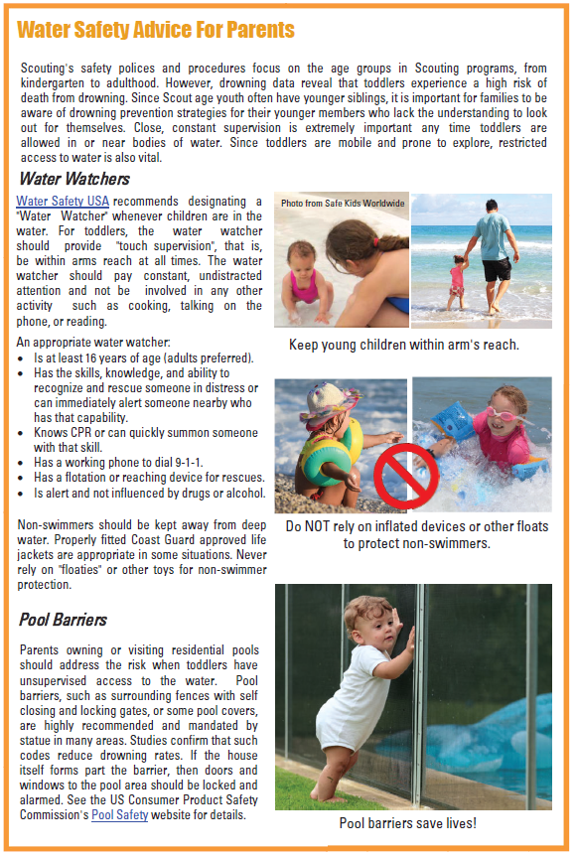

Slide 14
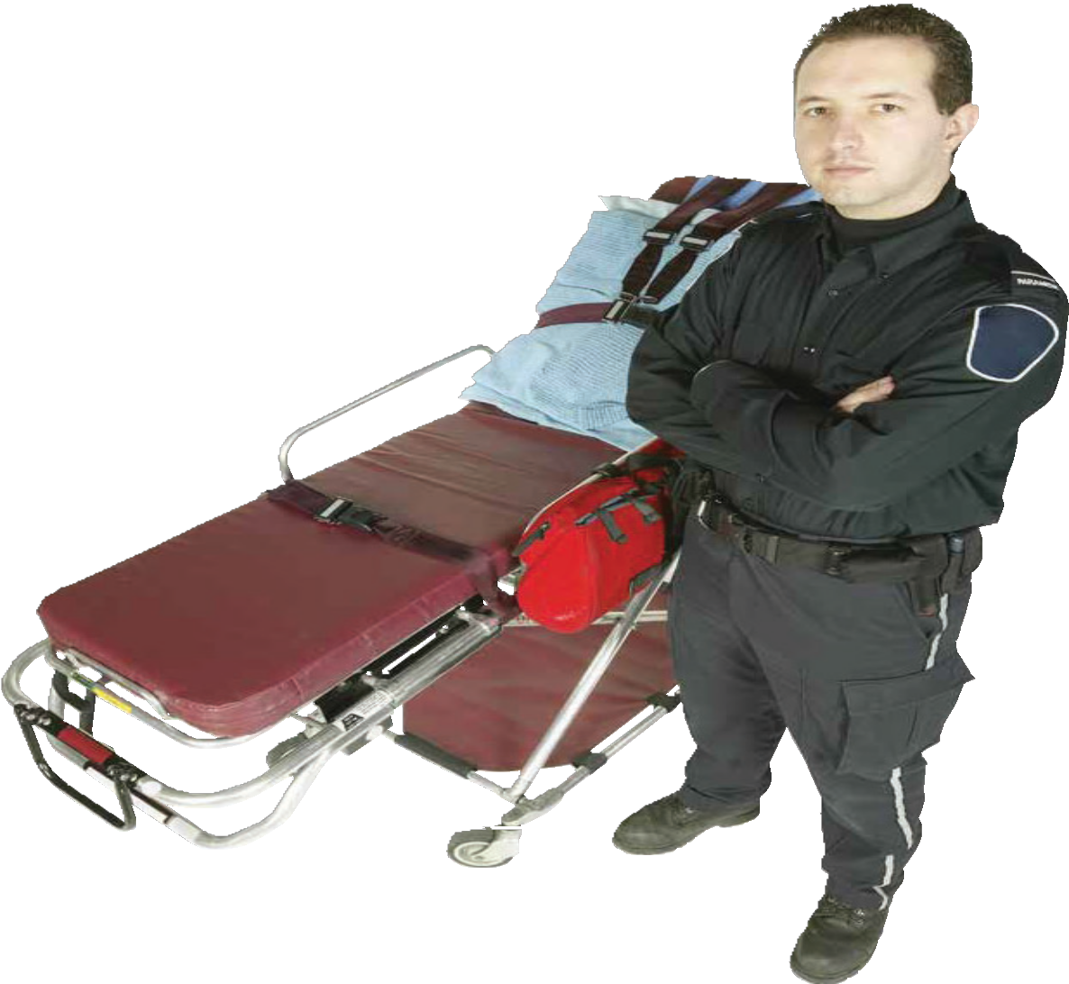
The Greatest Risk:
In good years, no one drowns at Scouting events. In tragic years, drowning incidents may be counted on the fingers of one hand. However, year after year, two or more hands are needed to count the number of adults who die during Scouting activities. The number one cause of death in Scouting and for the public at large is heart disease. Statistically, unit leaders are less likely to need to rescue a youth from drowning than they are to need aid themselves to survive cardiac arrest in the water.
In response, the BSA has implemented various initiatives such as annual physicals, activity restrictions based on height/weight ratios, and CPR/AED training. Leader fitness is also a common program theme. All adults should review the risk factors for heart disease and do what they can to mitigate those risks, particularly through exercise and a heart-healthy diet.
Although the first obvious symptom of a problem often appears to be a fatal heart attack, nearly all patients have warning signs such as chest pains and breathlessness immediately before the attack.
During Scouting events, adult leaders need to watch out for each other as well as the youth under their care.
36 Chapter 4: Health Considerations

Slide 15
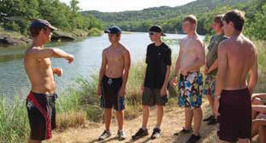
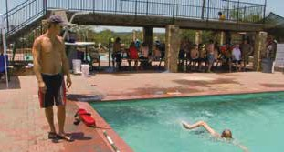
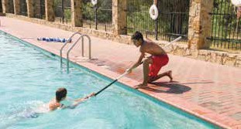
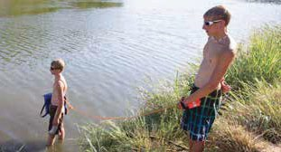
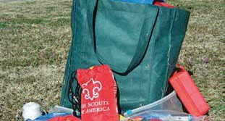
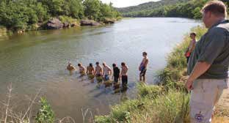
Remote Swimming Area Setup
1. Prior to the setup, check health histories.
5. For large units, use a small group of older youth and clearly explain roles.
2. Determine swimming abilities.
6. Safe Swim Defense applies during setup, so assign buddies.
3. Ensure adequate rescue training.
7. Assign response personnel.
4. Assemble a safe swim kit.
8. Post a lookout prior to water entry.
72 Chapter 7: Swimming Locations

Slide 16
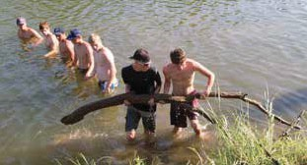
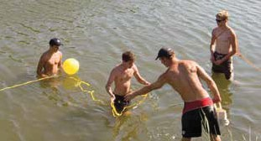
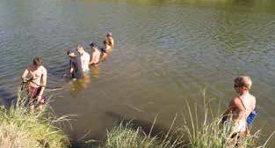
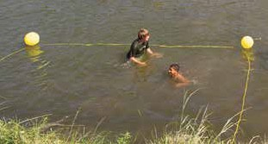
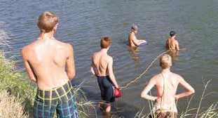
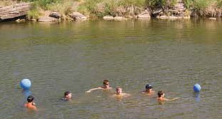
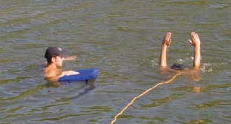
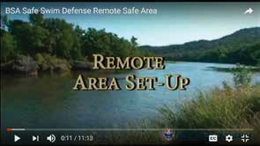
9. Check shallow water with a line of swimmers wearing shoes.
13. After the site is checked for hazards, mark the area for the ability groups.
10. Sweep parallel to shore.
14. Use floating rope to enclose nonswimmer and beginner areas.
11. Use a single good swimmer to check deep water using feetfirst surface dives.
15. Boundary floats are sufficient for the swimmer area.
12. A safety line and safety swimmer may be used.
For more detail, view the remote area setup video listed on the Aquatics Resources webpage at www.scouting. org/outdoor-programs/aquatics/forms/.
Chapter 7: Swimming Locations 73

Slide 17
Reference – Aquatics

